Slide 1
Latent variable models
Session 1 – Introduction

Slide 2
Teachers
Dr. Marjolein Fokkema
m.fokkema@fsw.leidenuniv.nl
Dr. Julian Karch
j.d.karch@fsw.leidenuniv.nl
Methodology and Statistics Unit
Leiden University
Notes:
Introduction
Who are you?
And why are you here?

Slide 3
Class outline
General administrative stuff
Introduction to structural equation modeling (SEM)
Selected topics from chapter 2 of Beaujean
Exercises / lab session

Slide 4
Course schedule
 | Monday 06.07. |  | Wednesday 08.07. | Friday 10.07.
10:00-13:00 | Introduction / path models |  | Latent growth curve models | Measurement invariance / multiple group models
13:00-14:00 | Lunch break
14:00-16:30 | Confirmatory factor analysis | Confirmatory factor analysis 2: non-continuous data |  | Miscellaneous

Slide 5
Course prerequisites
Knowledge of statistics
Statistical testing (e.g., chi-square & normal distributions)
Regression (GLMs)
Var, cov, cor, mean
Knowledge of psychometrics
Validity
PCA, EFA, CFA
Reliability
IRT
Matrix algebra
Addition, multiplication, diagonal, inverse
Programming in R

Slide 6
Course materials
Beaujean, A. A. (2014). Latent variable modeling using R: A step-by-step guide. Routledge.
R code for book’s examples available on web
http://blogs.baylor.edu/rlatentvariable/sample-page/r-syntax/
Also available in annotated code files on github
Lecture sheets on github
Annotated code files on github ( .pdf)
If you prefer to have multiple resources: lavaan’s tutorial is concise and helpful
lavaan.ugent.be/tutorial/index.html

Slide 7
Structural Equation Modeling
SEM: the modeling of structural equations
Modeling: we are constructing models (hypotheses, theories) of reality. The models (theory, hypothesis) can be statistically tested. That is: rejected by the data (or not), but never proven ‘true’ or ‘right’.
In fact, all models are wrong, but some are useful approximations to reality. So a statistic (e.g., p-value) itself does not decide whether a model is right or wrong. We have to decide whether a fitted model or parameter estimate provides useful information
Structural: the model is used to explain the interrelations between (that is, the structure of) observed variables
Equations: the interrelations between variables in the model are described using mathematical formulae (equations)

Slide 8
Structural Equation Modeling
SEMS are graphically represented using the following building blocks:
Observed (manifest) variable
Directional relationship (regression relationship)
Non-directional relationship
(correlation/(co)variance)
Latent variable
Constant term (i.e., not a variable, e.g., intercept)

Slide 9
Structural Equation Modeling
The arrows in SEM denote regression relationships, of the linear type
Therefore, all generalized linear models (GLMs) can also be formulated as SEM models, e.g.,
t-test
ANOVA
Multiple linear regression
Multiple logistic regression
…..
Also, SEM can be used to models for multilevel or longitudinal data (i.e., GLMMs, or generalized linear mixed-effects models)

Slide 10
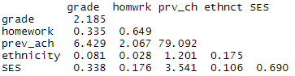
Example dataset
Variables in the model:
GPA in 10th grade
Ethnicity
Homework (8th grade)
Previous achievement (8th grade)
Socio-economic status
Sample covariance matrix S:
grade
ethnicity
homework
SES
Prev_ach

Slide 11
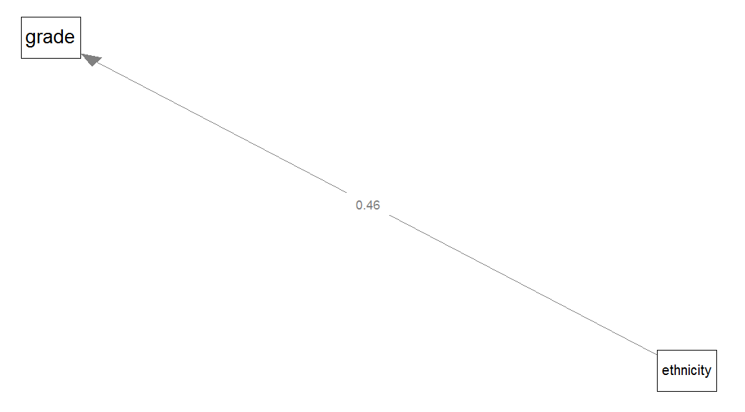

Model: Univariate regression
Dependent:
GPA in 10th grade
Independent:
ethnicity (0=ethnic minority; 1=ethnic majority)
Regression coefficient easy to calculate by hand:
${\hat{b}}_{xy}=$ $\frac{{cov}_{x,y}}{{var}_{x}}=\frac{0.0814}{0.1752}\text{=0.4646}$
standardized ${\hat{b}}_{xy}=$ ${\hat{ρ}}_{xy}=$ $\frac{{cov}_{x,y}}{s_{x}s_{y}}=s_{x}\frac{{\hat{b}}_{xy}}{s_{y}}=0.132$
Measure of fit or (strength of) association: ${{\hat{ρ}}_{xy}}_{}^{2}$

Slide 12
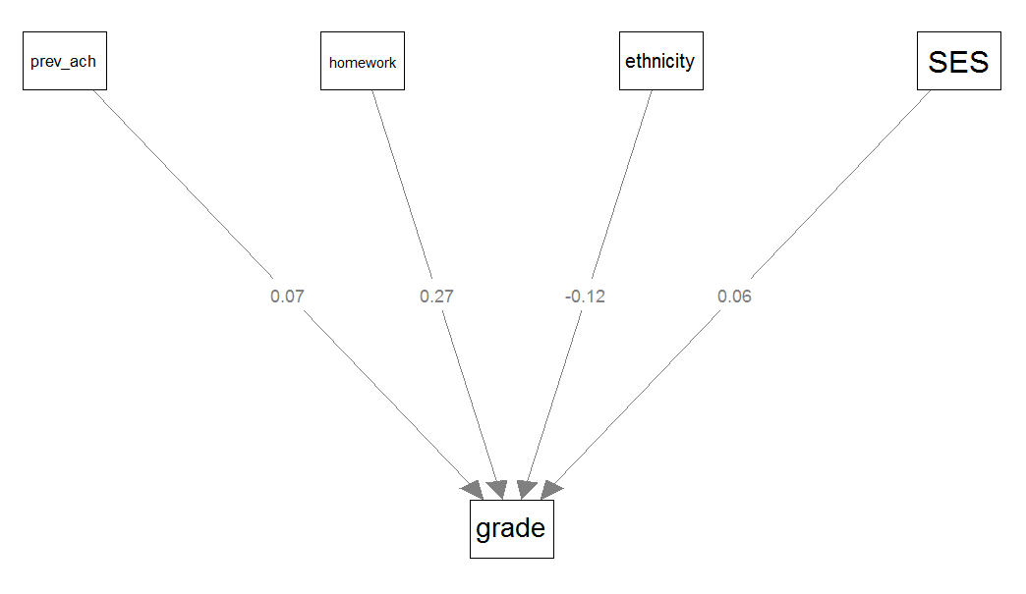

Model: Multiple regression
Dependent:
GPA in 10th grade
Independent:
Ethnicity
Homework (8th grade)
Previous achievement (8th grade)
Socio-economic status
Regression estimates are now a vector of partial regression coefficients, need matrix algebra to compute: $\hat{β}={{(X}^{T}X)}^{−1}X^{T}y$
Measure of fit: multiple correlation (R=.512), or variance explained (R²=.262)
Measure of (strength of) association: ${\hat{b}}_{xy}$ or standardized ${\hat{b}}_{xy}=s_{x}\frac{{\hat{b}}_{xy}}{s_{y}}$ (where ${\hat{b}}_{xy}$ is now a partial regression coefficient)

Slide 13
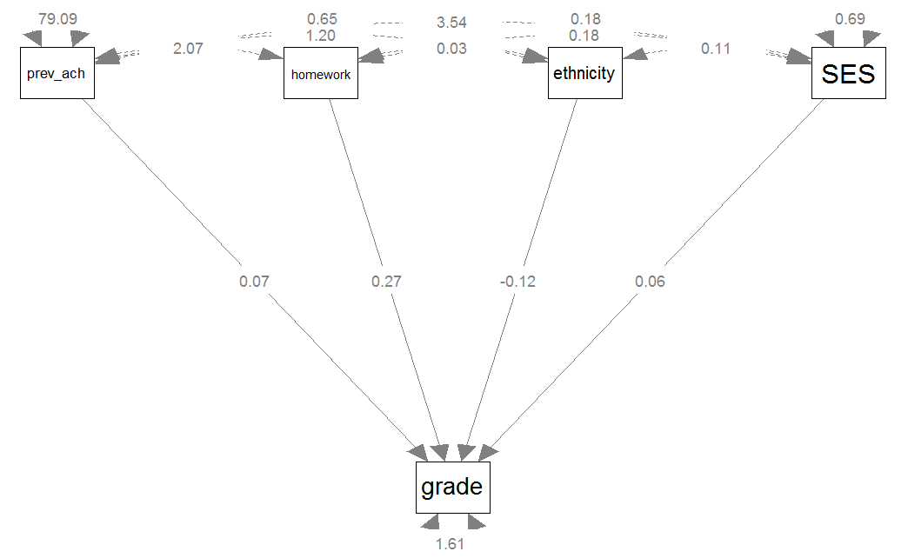

Model: SEM
Endogenous variables:
GPA in 10th grade
Exogenous variables:
Ethnicity
Homework (8th grade)
Previous achievement (8th grade)
Socio-economic status
(disturbance/error/residual) of GPA in 10th grade
Regression estimates are still a vector of partial regression coefficients, need matrix algebra and optimization to compute
Measure of (strength of) associations: Partial regression coefficients
Overall model fit: How well are the observed variables’ (co)variances reproduced by the model?
Quantified by a $χ^{2}$value and model fit indices

Slide 14
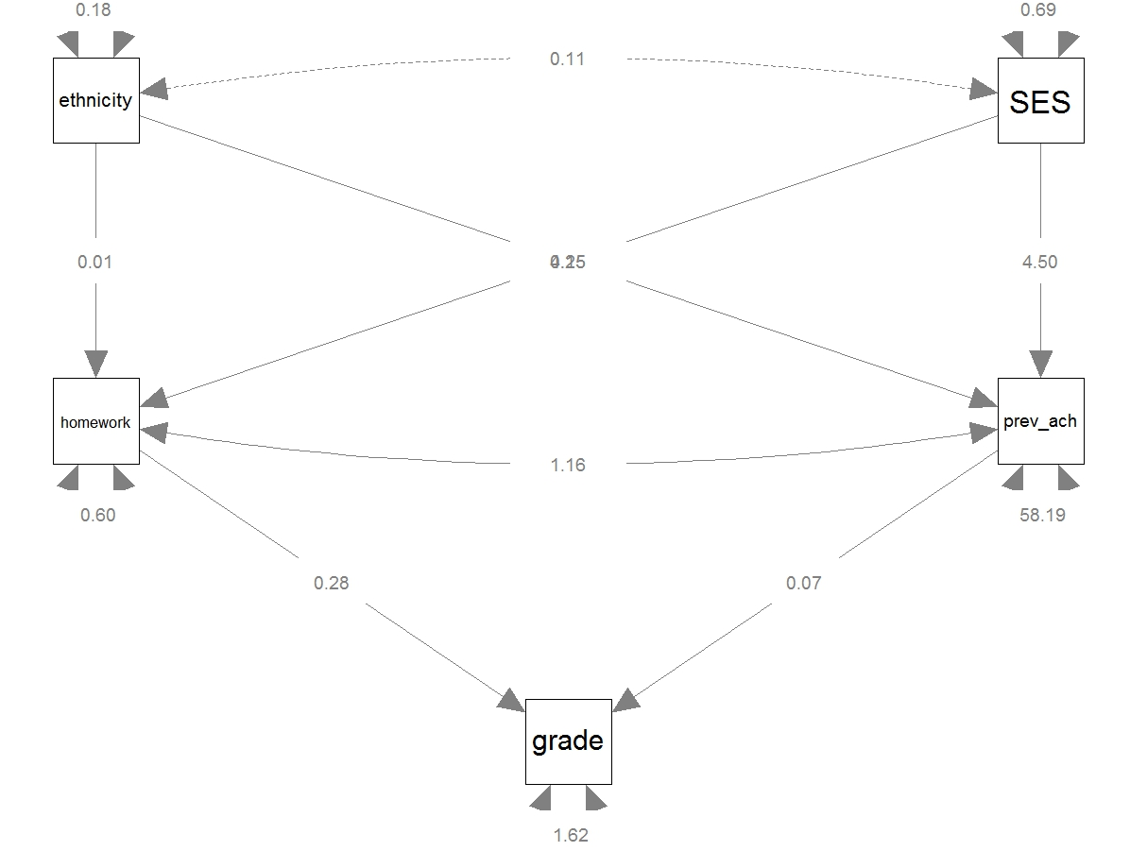

Model: SEM
Endogenous variables:
Homework (8th grade)
Previous achievement (8th grade)
GPA in 10th grade
Exogenous variables:
Ethnicity
Socio-economic status
(disturbances/errors/residuals of
Homework (8th grade)
Previous achievement (8th grade)
GPA in 10th grade
Measure of (strength of) associations: partial regression coefficients
Overall model fit: How well are the observed variables’ (co)variances reproduced by the model?
Quantified by a $χ^{2}$value and model fit indices

Slide 15

Model: SEM
From Greek endo, meaning ‘inside’, and gignomai
Explained by the model.
Have unidirectional incoming arrows.
Endogenous variables:
Homework (8th grade)
Previous achievement (8th grade)
GPA in 10th grade
Exogenous variables:
Ethnicity
Socio-economic status
(disturbances/errors/residuals of
Homework (8th grade)
Previous achievement (8th grade)
GPA in 10th grade
Measure of (strength of) associations: partial regression coefficients
Overall model fit: How well are the observed variables’ (co)variances reproduced by the model?
Quantified by a $χ^{2}$value and model fit indices
Not explained by the model.
Have no unidirectional incoming arrow(s).
From Greek exo, meaning ‘outside’, and gignomai, meaning ‘to produce’

Slide 16
SEM using lavaan
To fit a SEM in R with lavaan, we need two things:
A dataset, which can be:
Raw data, which is often an external file (e.g., .sav, .xls) which needs to be loaded into R (most often the case in practice)
Covariance or correlation matrix, which can be an external file, or can be entered manually (most often the case in the book’s examples and exercises)
A model specification:
A long character string that specifies whether population parameters (associations) are restricted (e.g., to a constant like 1 or 0, or to equality) or should be freely estimated, using lavaan model syntax

Slide 17
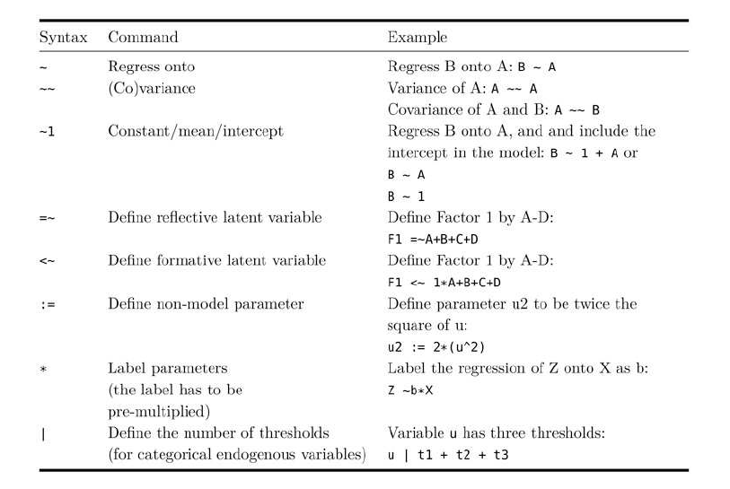
Lavaan model syntax

Slide 18
Lavaan model syntax

Slide 19
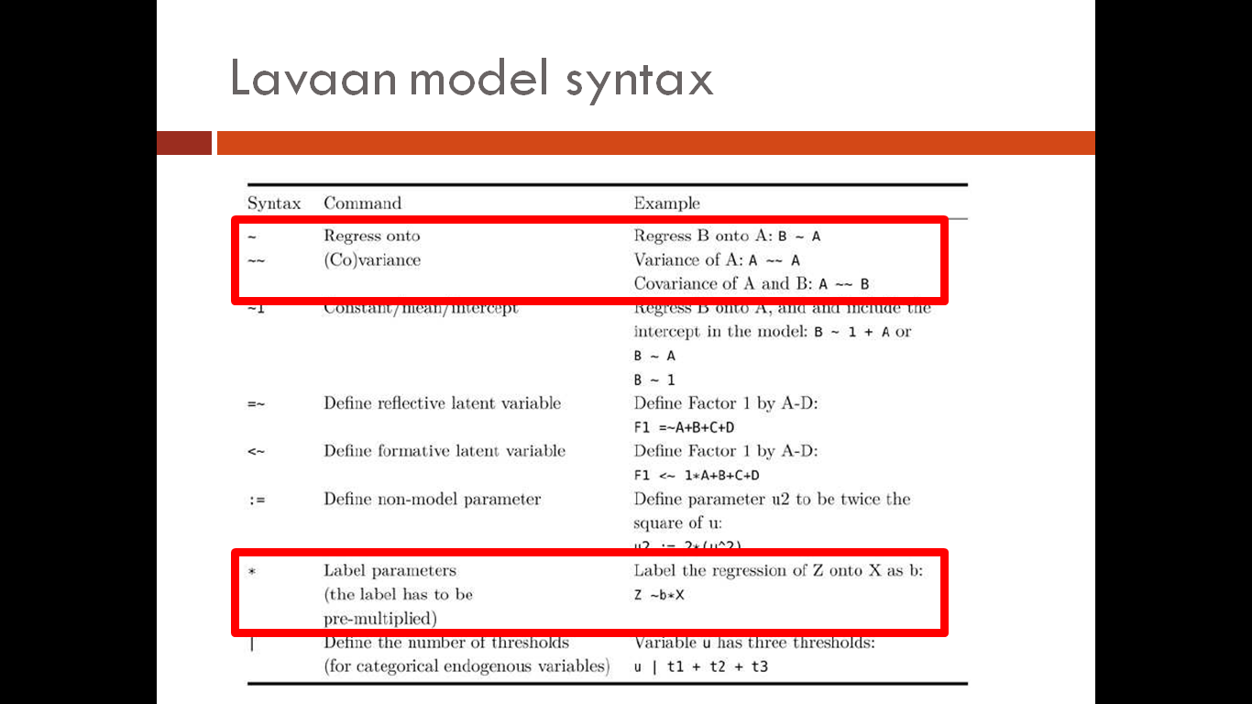
Lavaan model syntax
Note that errors are (the only) latent variables that do not have to be defined explicitly
By default, any endogenous variable (e.g., B in the first example above) gets an associated error variable with a path coefficient of 1, and the variance of the error variable is freely estimated
Covariances between exogenous variables are automatically included
To set to zero manually, multiply by zero, e.g.:
A ~~ 0*B

Slide 20
Lavaan Examples

Slide 21
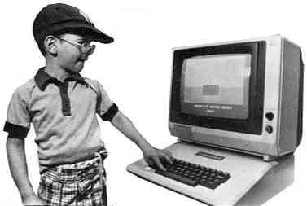
Computation time!
Make Exercise 2.1

Slide 22
Structural Equation Modeling
The model is used to explain the structure of, or the interrelations between the observed variables
More specifically, to explain covariances between observed variables:
A covariance matrix contains all (co)variances of the observed variables in the model

Slide 23
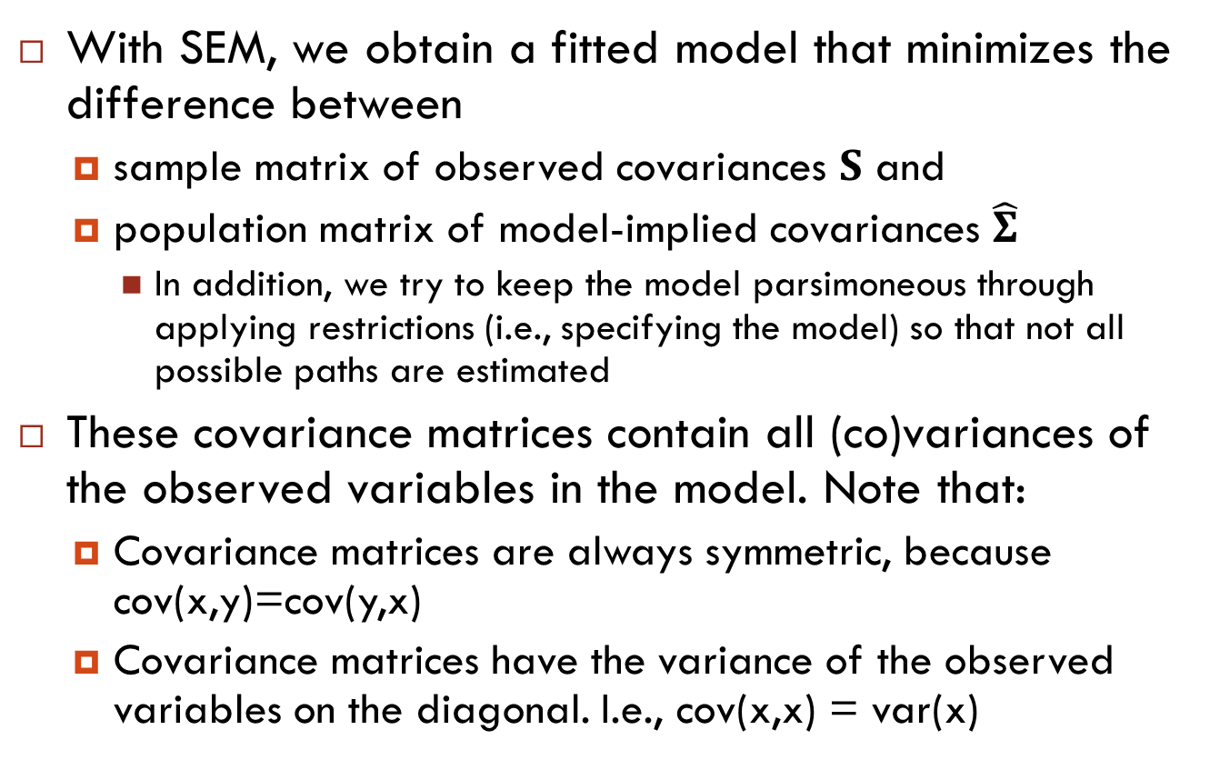
Structural Equation Modeling
With SEM, we obtain a fitted model that minimizes the difference between
sample matrix of observed covariances $S$ and
population matrix of model-implied covariances $\hat{Σ}$
In addition, we try to keep the model parsimoneous through applying restrictions (i.e., specifying the model) so that not all possible paths are estimated
These covariance matrices contain all (co)variances of the observed variables in the model. Note that:
Covariance matrices are always symmetric, because cov(x,y)=cov(y,x)
Covariance matrices have the variance of the observed variables on the diagonal. I.e., cov(x,x) = var(x)

Slide 24
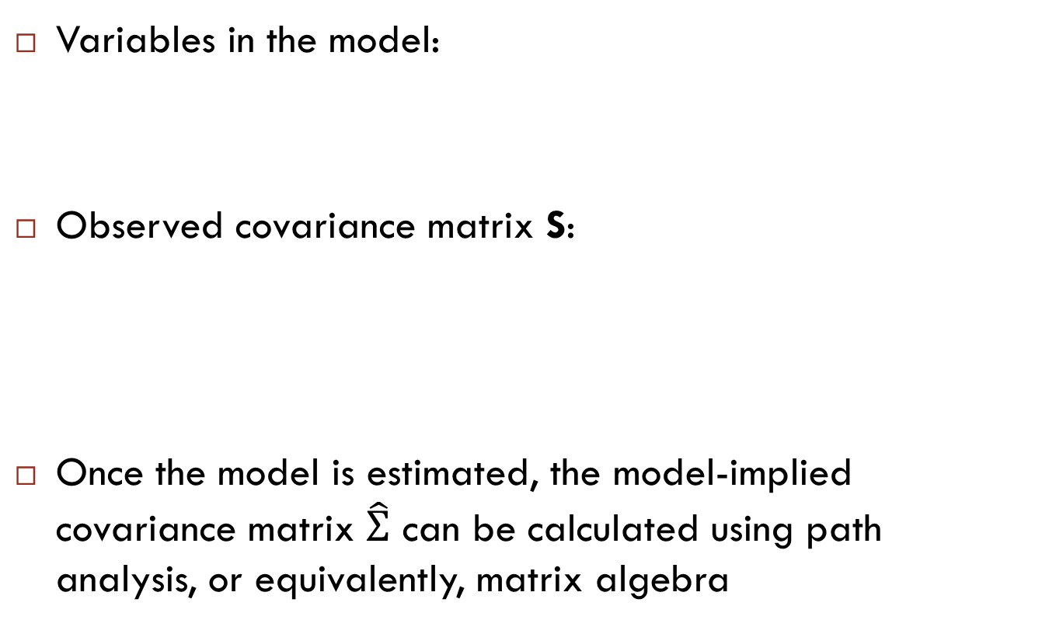
Model-implied (co)variances
Variables in the model:
Observed covariance matrix S:
Once the model is estimated, the model-implied covariance matrix $\hat{Σ}$ can be calculated using path analysis, or equivalently, matrix algebra
grade
ethnicity
homework
SES
Prev_ach

Slide 25
Matrices of a SEM
A SEM model consists of several matrices of parameters
Let P be the number of observed variables in the model
In the earlier examples (involving observed variables only), we have
β: a PxP matrix of regression coefficients, relating predictor to criterion variables
‘Contains’ single-headed (directed) arrows, therefore non-symmetric
Ψ: a PxP matrix of (co)variances not explained by the regression equations
‘Contains’ double headed (undirected) arrows, therefore symmetric
β and Ψ describe the structural model
Often, SEM models also involve a measurement model (described by Λ and Θ; introduced in the afternoon)

Slide 26
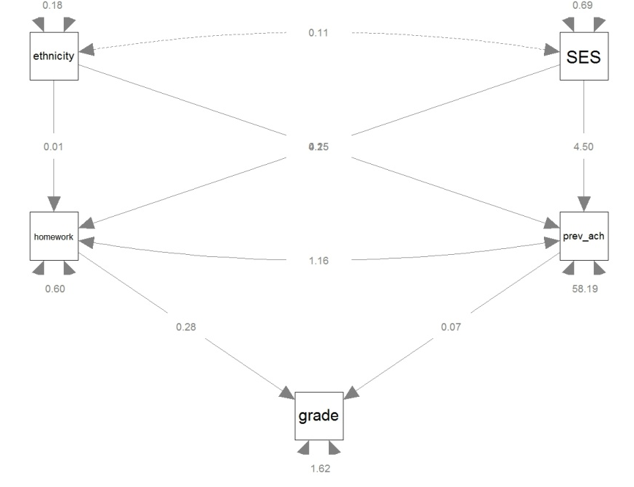
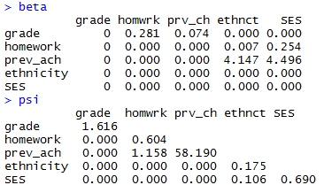
Structural model (no measurement model)
Notes:
Psi: symmetric
Beta: non-symmetric. If A ~ B, then A is on row, B is on column

Slide 27
Structural and measurement model
Two main components of SEMs are distinguished
the structural model showing potential causal dependencies between endogenous and exogenous variables
path diagrams can be viewed as SEMs that contain only the structural part
the measurement model showing the relations between latent variables and their indicators
exploratory and confirmatory factor analysis models contain only the measurement part

Slide 28
Some matrix algebra
In lavaan, all SEMs are defined by four parameter matrices (which give the model-implied covariance matrix sigma_hat):
Today, our models involve no measurement part, this simplifies to:
Equation above is exactly the same thing as using tracing rules to calculate model-implied (co)variances
with many variables, path analysis becomes tedious and error prone

Slide 29
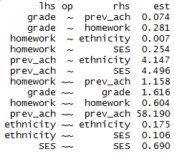
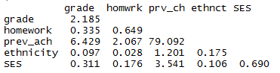

Model-implied (co)variances
Model: Parameter estimates:
$\hat{Σ}$ : S

Slide 30
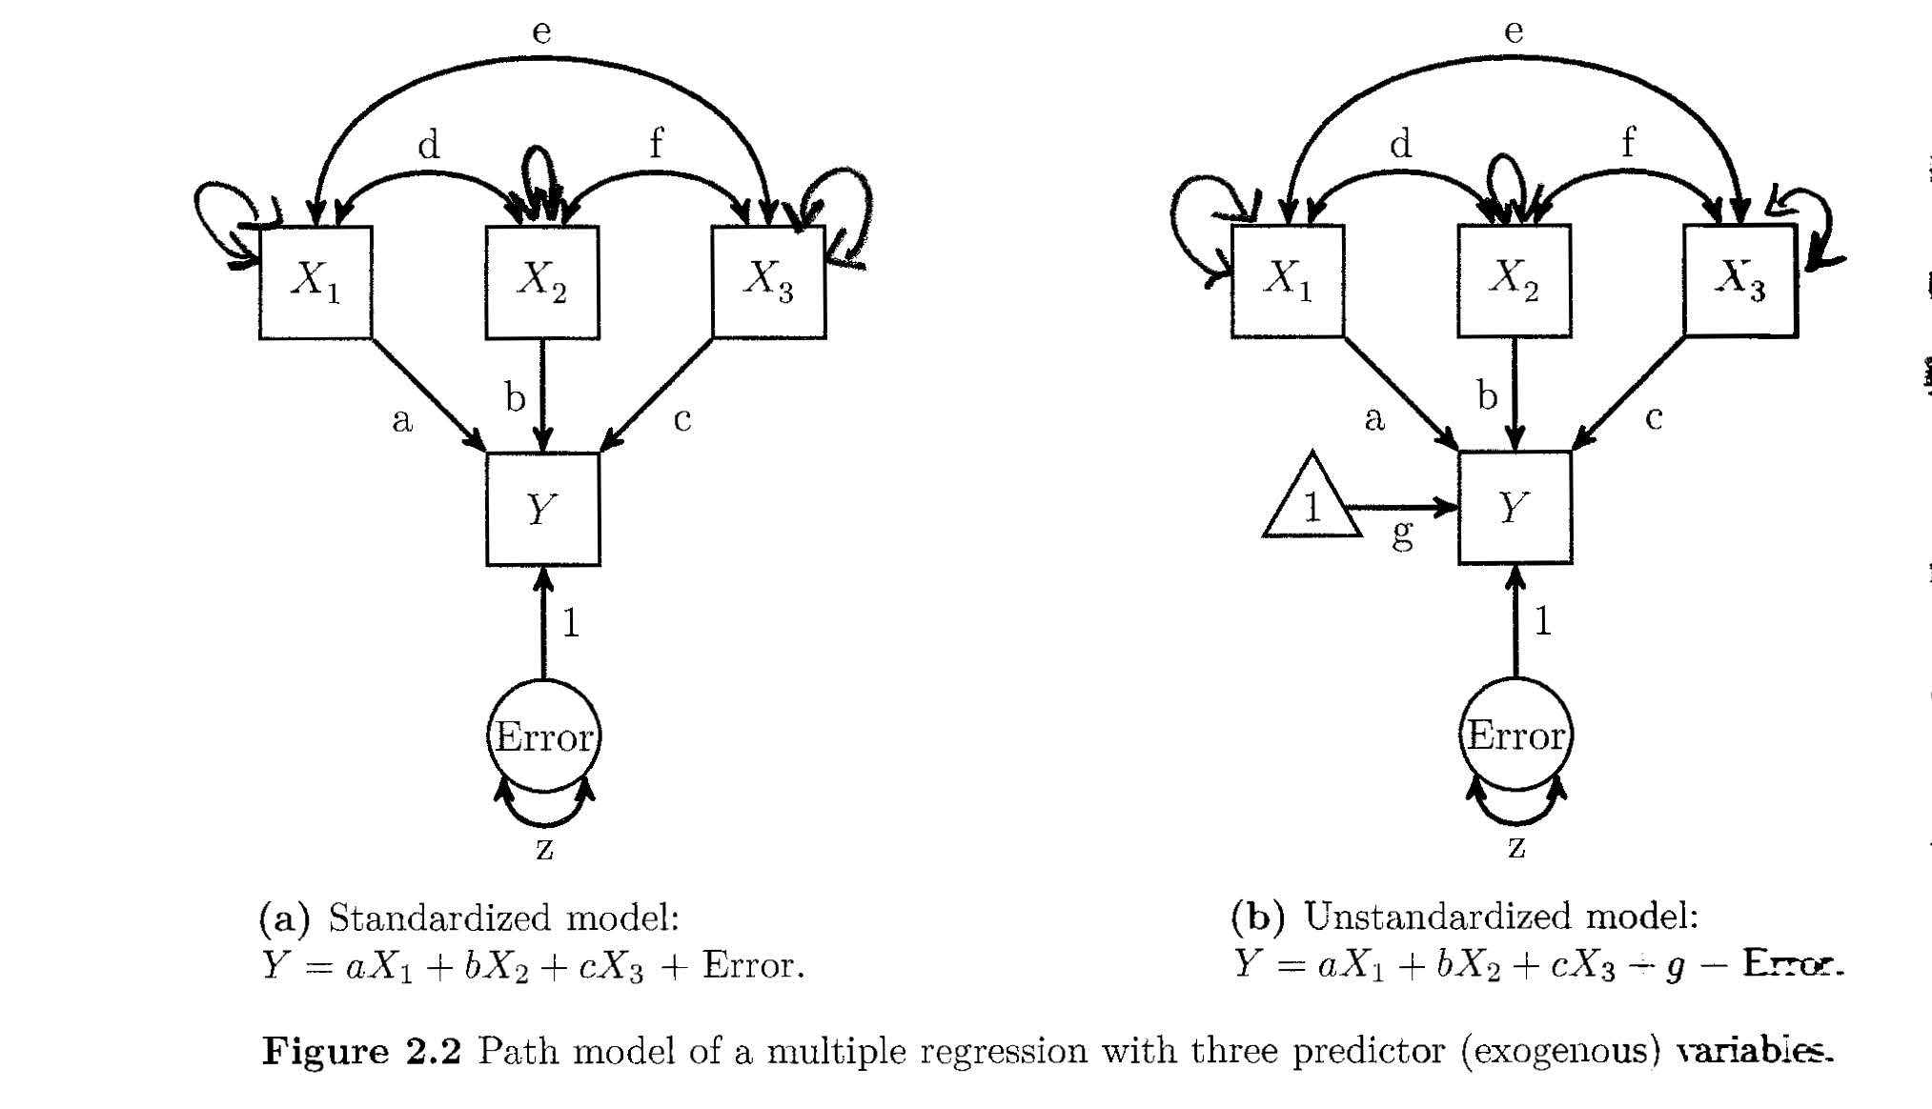
Variances of exogenous variables often not explicitly depicted

Slide 31
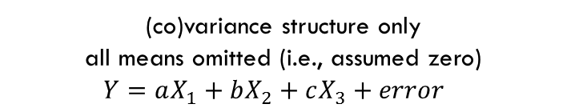
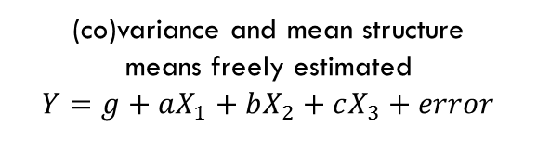
Mean structure often omitted
(co)variance structure only
all means omitted (i.e., assumed zero)
$Y=aX_{1}+bX_{2}+cX_{3}+error$
(co)variance and mean structure
means freely estimated
$Y=g+aX_{1}+bX_{2}+cX_{3}+error$

Slide 32
Error terms
Errors are latent variables: they are hypothetical, not directly observed
Error is defined as the difference between observed (sample) variance and variance explained by other variables in the model
Therefore, a variable that has an error/disturbance term is an endogenous variable
Errors/disturbance terms are always exogenous (have no incoming directional arrows)

Slide 33
Causation
Causation is a function of the research design, and cannot be determined statistically
Both models above will fit the observed data equally well, it is up to the researcher to decide on the direction of the arrows
But note that the estimated regression coefficient will be different in each model, as it depends on the scale of the exogenous and endogenous variables
error
X
Y
error
Y
X

Slide 34
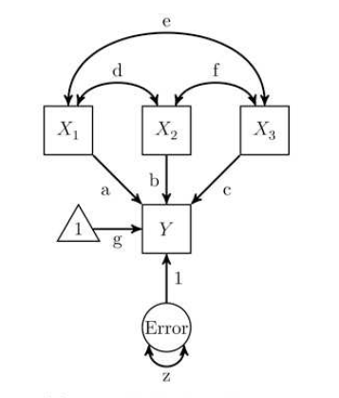
Path & partial regression coefficients
Path coefficients (a, b, c, g and 1) are partial regression coefficients
That is, the expected increase in the response variable, when the predictor variable increases by 1, controlling for (= keeping constant) all the other predictor variables
Note that the intercept is always 1, so cannot in- or decrease

Slide 35
Standardized coefficients
Parameter estimates (path coefficients) can be standardized and unstandardized
Unstandardized: Interpret like regression coefficients
Expected increase in Y if X increases by 1
Standardized: Interpret like correlation coefficients
Expected increase in SDs of Y if X increases by 1 SD
0: no linear association; -1: perfect negative association; 1: perfect positive association
squared standardized coefficient = prop. of variance in Y explained by X (vice versa)

Slide 36
Exercises
Continue with exercises
Notes:
Give them password
Who does not have the book?

